Slide 1

Neural Machine Translation
汤斯亮（Siliang Tang）
siliang@zju.edu.cn

Slide 2
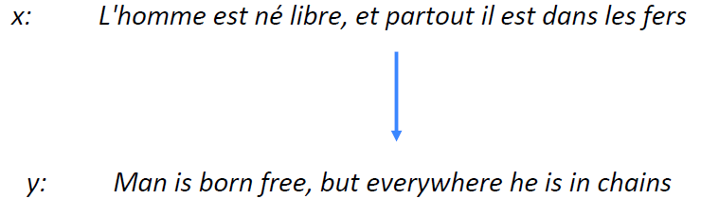
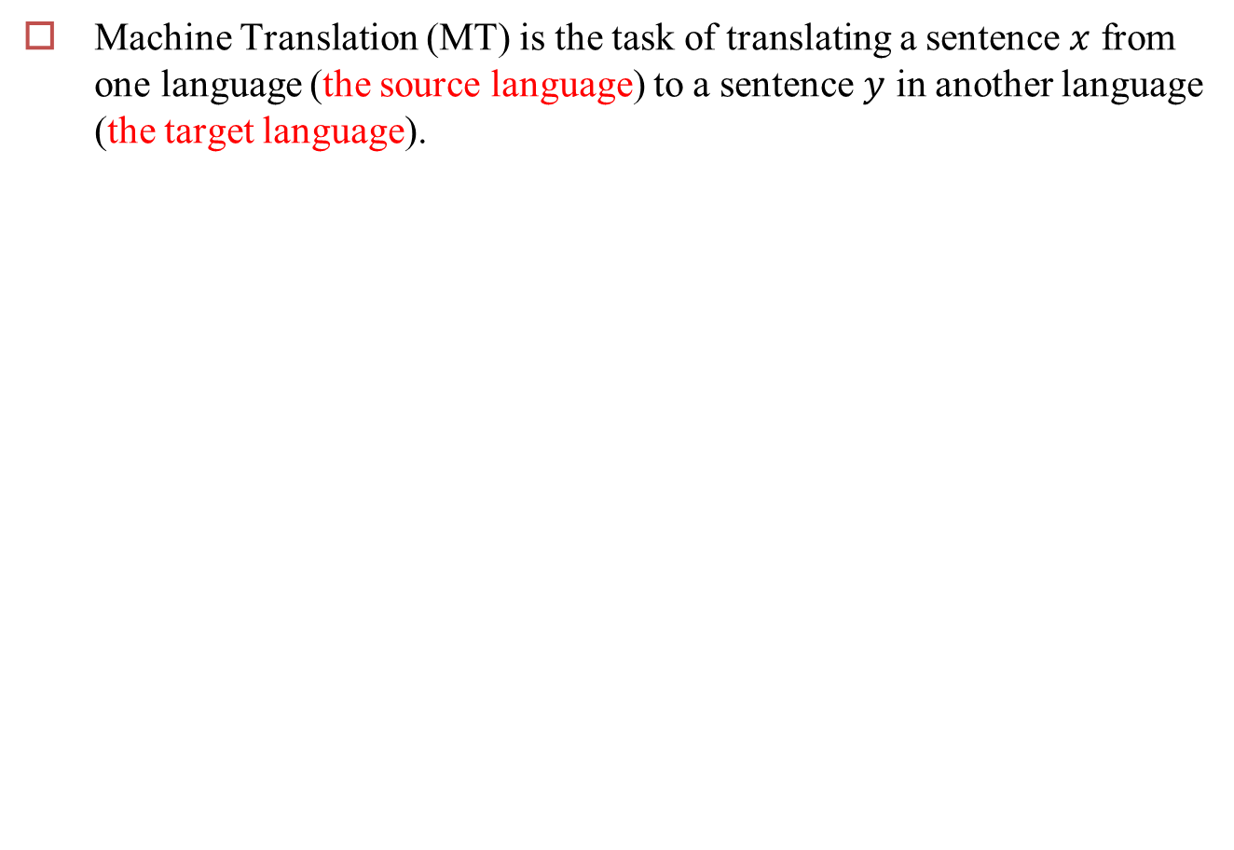
Machine Translation
Machine Translation (MT) is the task of translating a sentence $x$ from one language (the source language) to a sentence $y$ in another language (the target language).

Slide 3
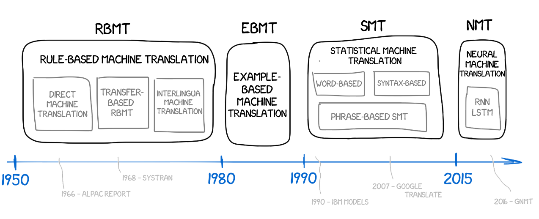
Brief History of MT
Warren Weaver
Automatic Language Processing Advisory Committee

Slide 4
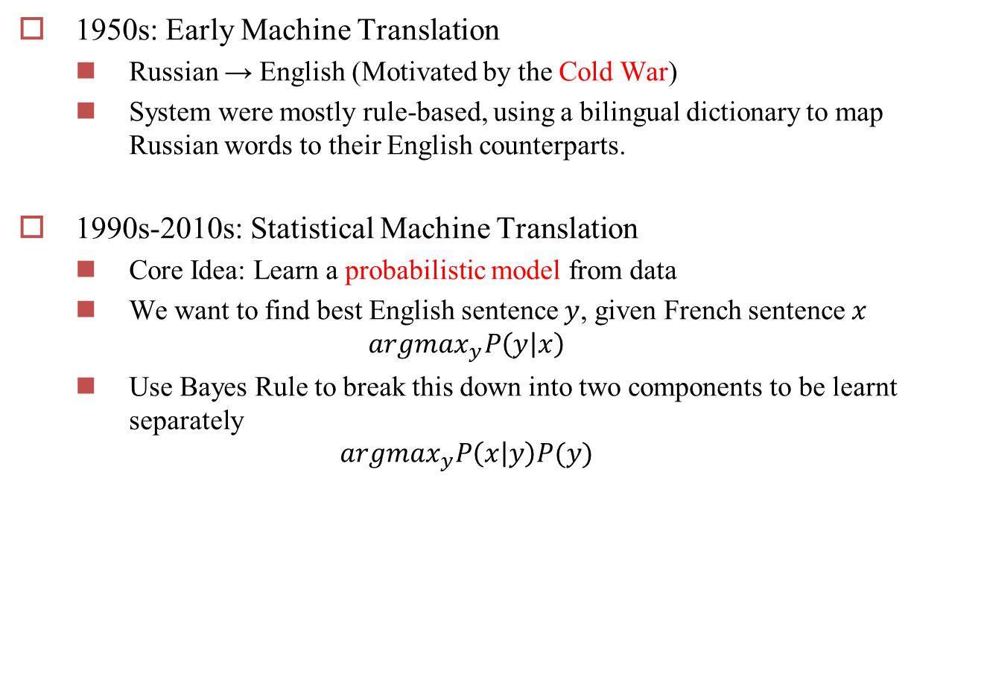
Brief History of MT
1950s: Early Machine Translation
Russian → English (Motivated by the Cold War)
System were mostly rule-based, using a bilingual dictionary to map Russian words to their English counterparts.
1990s-2010s: Statistical Machine Translation
Core Idea: Learn a probabilistic model from data
We want to find best English sentence $y$, given French sentence $x$
$$argmax_{y}P\left(y | x\right)$$
Use Bayes Rule to break this down into two components to be learnt separately
$$argmax_{y}P\left(x | y\right)P(y)$$

Slide 5
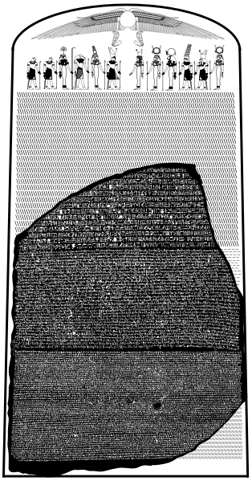

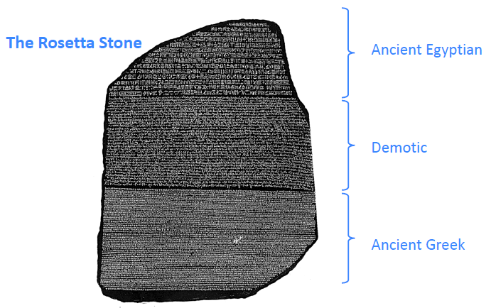
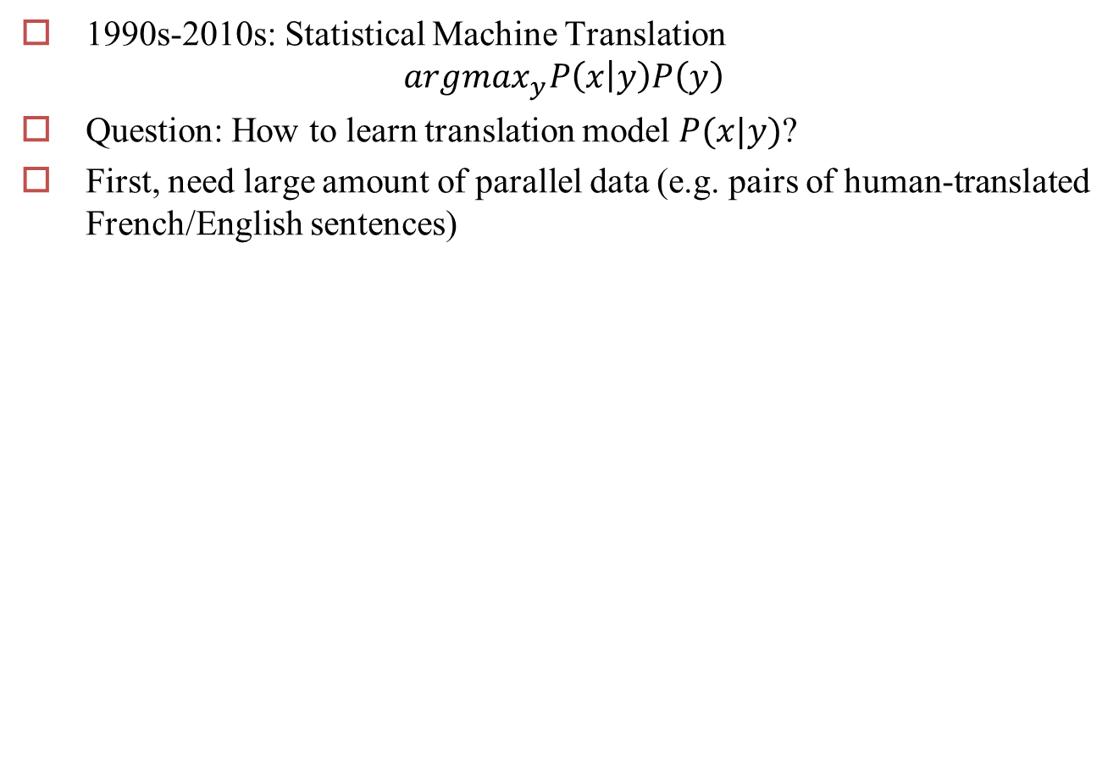
SMT
1990s-2010s: Statistical Machine Translation
$$argmax_{y}P\left(x | y\right)P\left(y\right)$$
Question: How to learn translation model $P(x|y)$?
First, need large amount of parallel data (e.g. pairs of human-translated French/English sentences)
https://en.wikipedia.org/wiki/Rosetta_Stone#/media/File:Rosetta_Stone.stl

Slide 6
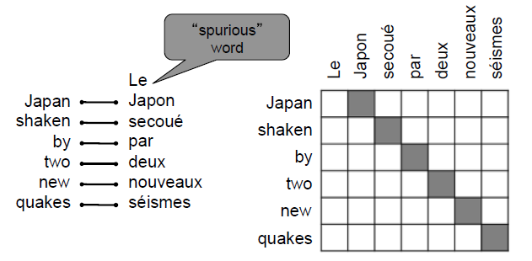
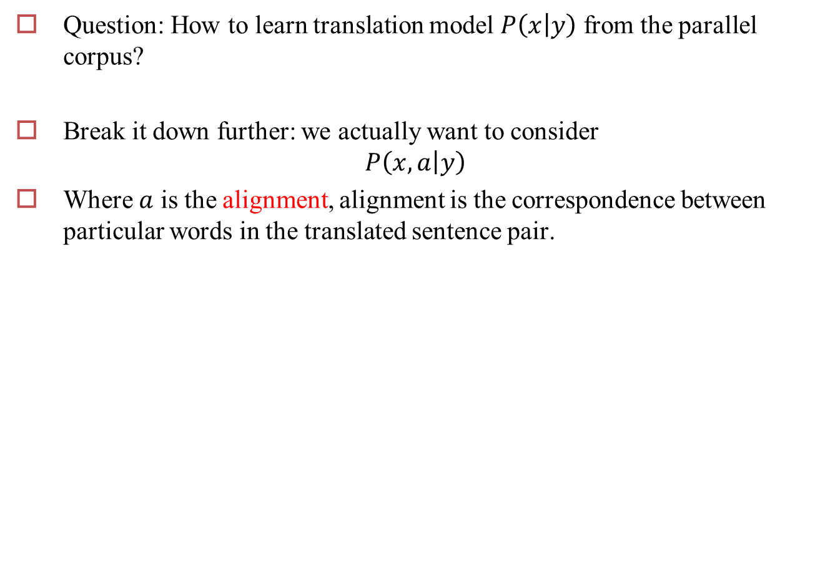
Learning alignment for SMT
Question: How to learn translation model $P\left(x | y\right)$ from the parallel corpus?
Break it down further: we actually want to consider
$$P\left(x,a | y\right)$$
Where $a$ is the alignment, alignment is the correspondence between particular words in the translated sentence pair.

Slide 7
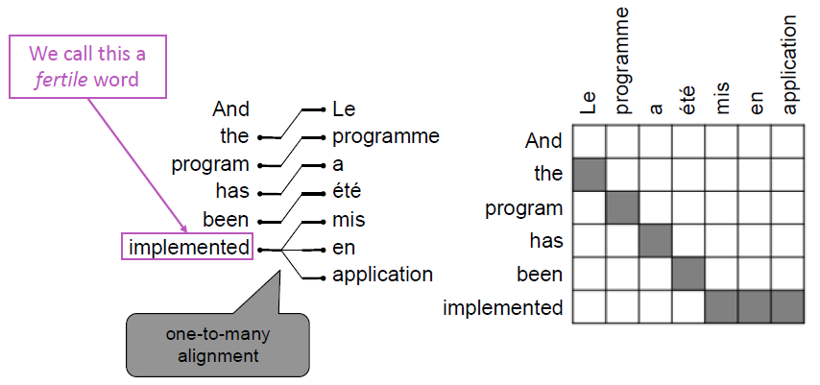
Alignment is complex
Alignment can be one-to-many

Slide 8
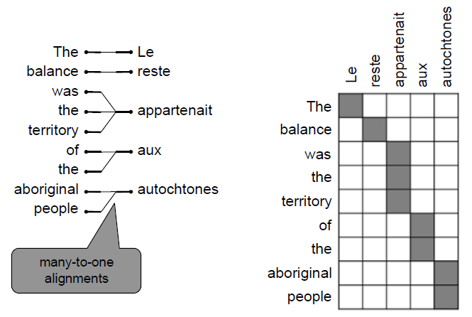
Alignment is complex
Alignment can be many-to-one

Slide 9
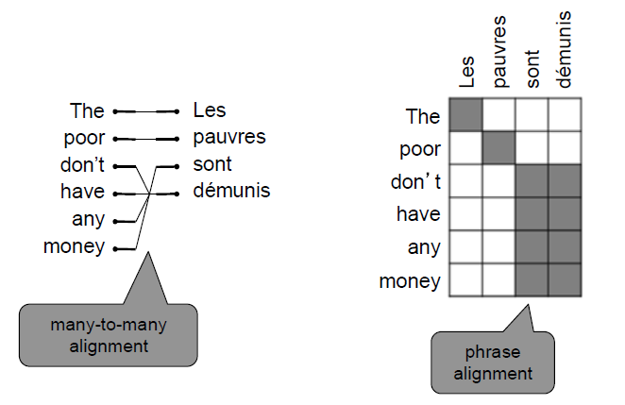
Alignment is complex
Alignment can be many-to-many (phrase-level)

Slide 10
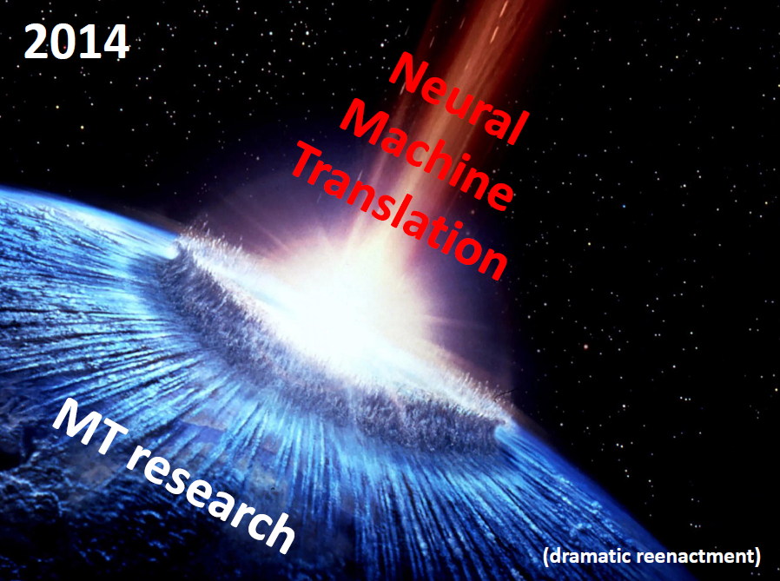
From SMT to NMT
Neutral Machine Translation (NMT) is a way to do Machine Translation with a single neural network
The neural network architecture is called sequence-to-sequence and it involves two RNNS.

Slide 11
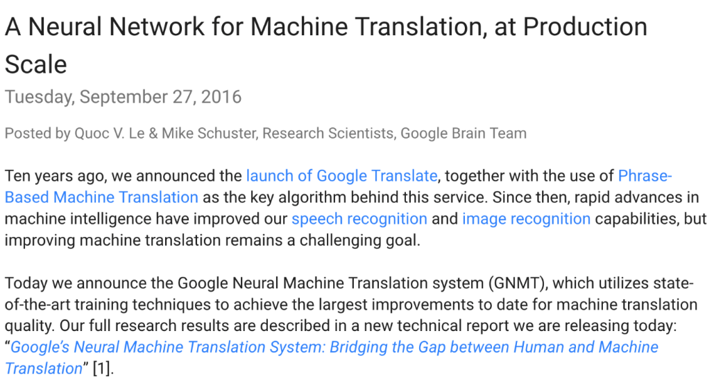
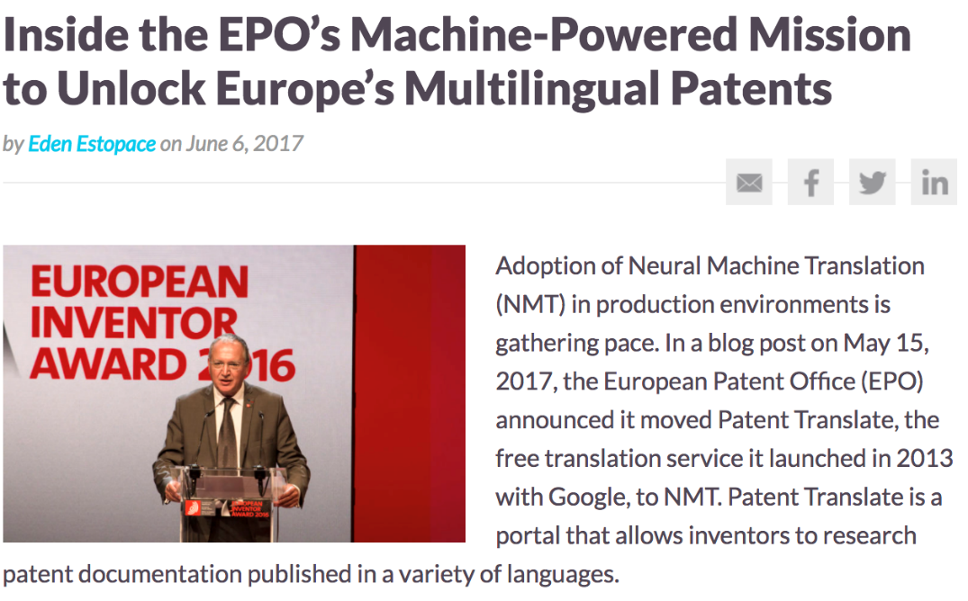
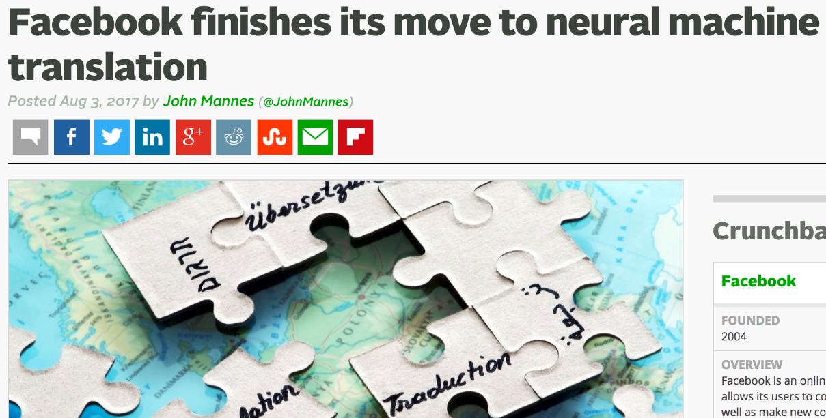
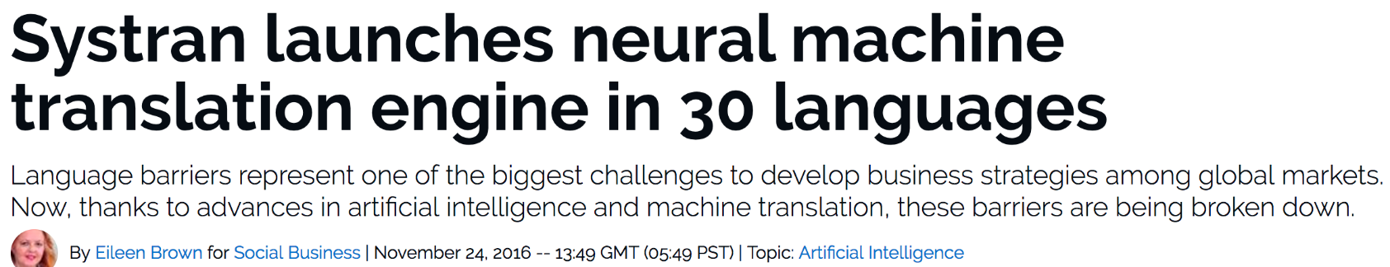
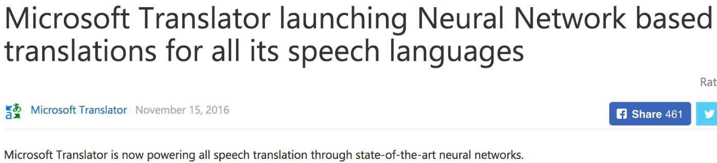
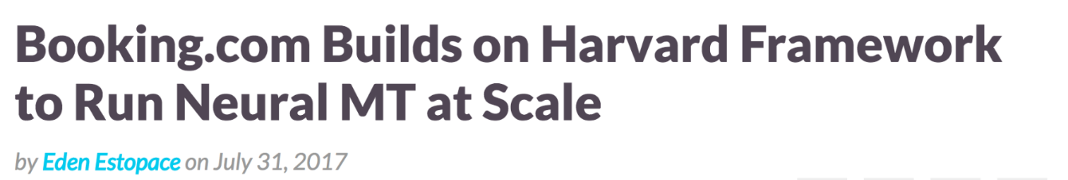
Neural MT is mainstream already

Slide 12

Neural MT
Original
Kilimanjaro is a snow-covered mountain 19,710 feet high, and is said to be the highest mountain in Africa. Its western summit is called the Masai “Ngaje Ngai,” the House of God. Close to the western summit there is the dried and frozen carcass of a leopard. No one has explained what the leopard was seeking at that altitude.
Back translation from Japanese (old)
Kilimanjaro is 19,710 feet of the mountain covered with snow, and it is said that the highest mountain in Africa. Top of the west, “Ngaje Ngai” in the Maasai language, has been referred to as the house of God. The top close to the west, there is a dry, frozen carcass of a leopard. Whether the leopard had what the demand at that altitude, there is no that nobody explained.
Back translation from Japanese (new)
Kilimanjaro is a mountain of 19,710 feet covered with snow, which is said to be the highest mountain in Africa. The summit of the west is called “Ngaje Ngai” God‘s house in Masai language. There is a dried and frozen carcass of a leopard near the summit of the west. No one can explain what the leopard was seeking at that altitude.

Slide 13
Neural Recurrent Sequence Models
Predict next token: P(Y) = P(Y1) * P(Y2|Y1) * P(Y3|Y1,Y2) * ...
Language Models, state-of-the-art on public benchmark
Y1
Y2
Y3
EOS
EOS
Y1
Y2
Y3

Slide 14
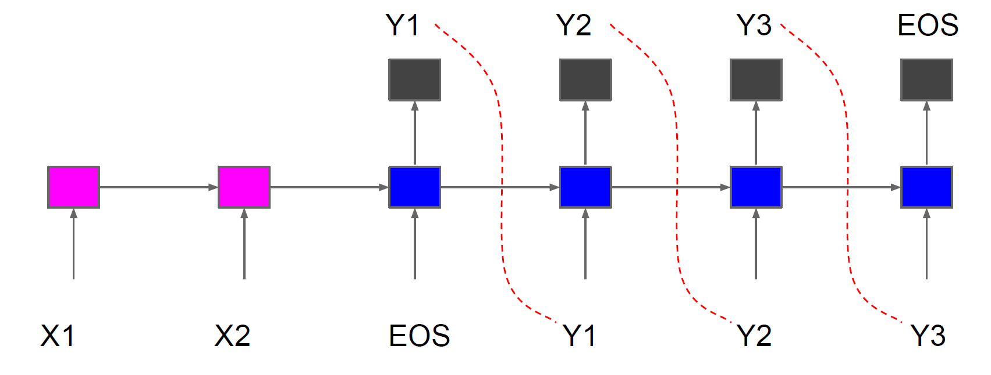
Sequence to Sequence
Learn to map: X1, X2, EOS -> Y1, Y2, Y3, EOS
Encoder/Decoder framework (decoder by itself just neural LM)
Theoretically any sequence length for input/output works

Slide 15
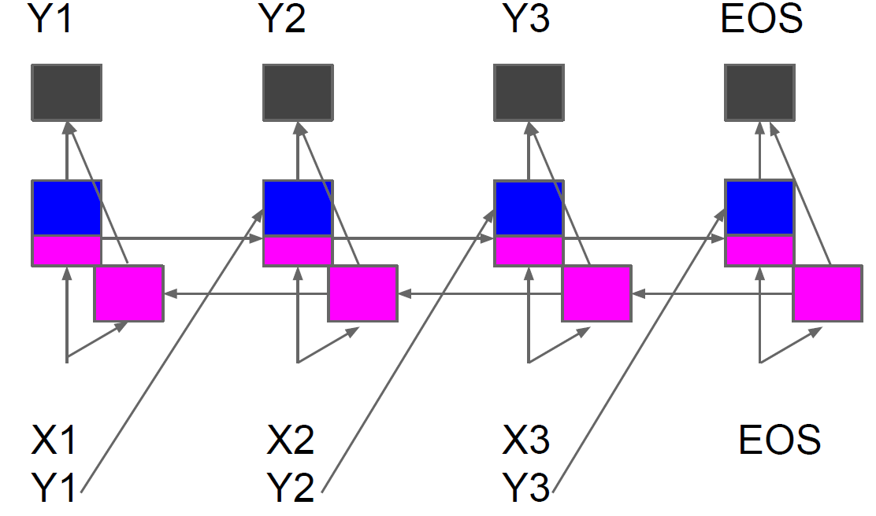
Sequence to Sequence in 1999...
NN for estimating directly P(Y|X) for equal length X and Y
Encoder (BRNN)/Decoder framework but in a single NN
NIPS 1999
Better Generative Models for Sequential Data Problems: Bidirectional Recurrent Mixture Density Networks

Slide 16
NMT
http://smerity.com/articles/2016/google_nmt_arch.html

Slide 17
Brief History of NMT
Sequence-To-Sequence models (NIPS 2014)
Based on many earlier approaches to estimate P(Y|X) directly
State-of-the-art on WMT En->Fr using custom software, very long training
Translation could be learned without explicit alignment!
Drawback: all information needs to be carried in internal state
Translation breaks down for long sentences!
Attention Models (2014)
Removes drawback by giving access to all encoder states
Translation quality is now independent of sentence length!

Slide 18
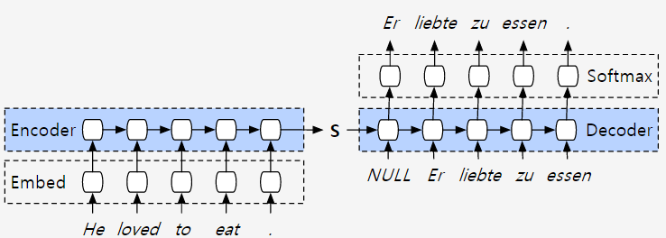
V1: Encoder-decoder
The encoder spits out a hidden state.
This hidden state is then supplied to the decoder, which generates the sentence in language B

Slide 19
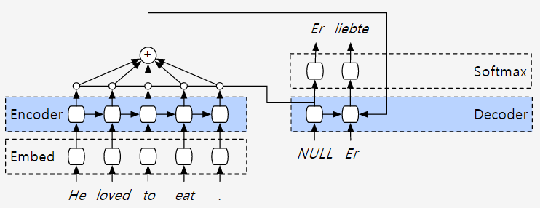
V2: Attention based encoder-decoder
The encoder query each output asking how relevant they are to the current computation on the decoder side

Slide 20
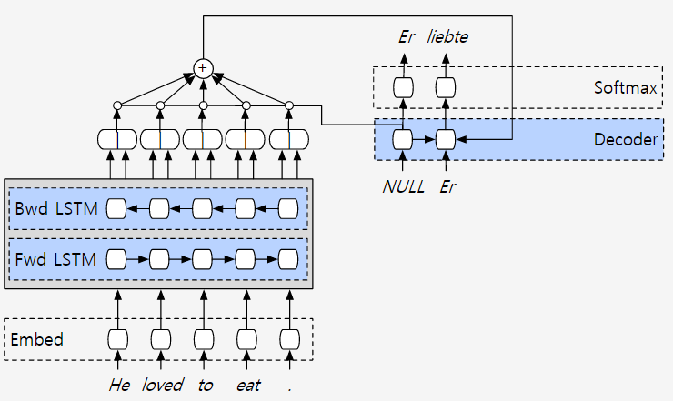
V3: Bi-directional encoder layer
We would like the annotation of each word to summarize not only the preceding words, but also the following words

Slide 21
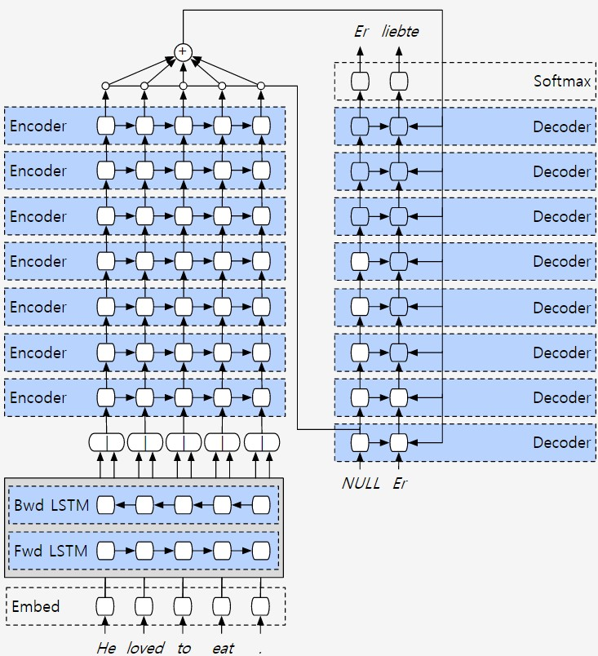
V4: "The deep is for deep learning"

Slide 22
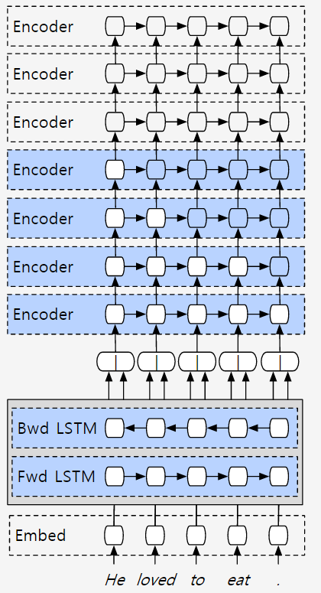
V5: Parallelization
To begin computation at one of the nodes, all of the nodes pointing toward you must already have been computed.
A layer 𝑖 + 1 can start its computation before layer 𝑖 is fully finished.

Slide 23
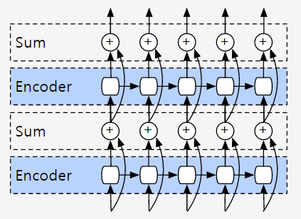
V6: Residuals are the new hotness
One solution for vanishing gradients is residual networks.
The idea of a layer computing an identity function

Slide 24
Translation Quality
+
6 = Perfect translation
Asian languages improved the most
Some improvements as big as last 10 years of improvements combined
△ Translation Quality
0.6-1.5
Translation Quality
+0.6
>0.5
>0.1
0 = Worst translation
Significant change &
Chinese to English
Almost all language pairs
Zh/Ja/Ko/Tr to English
launchable

Slide 25
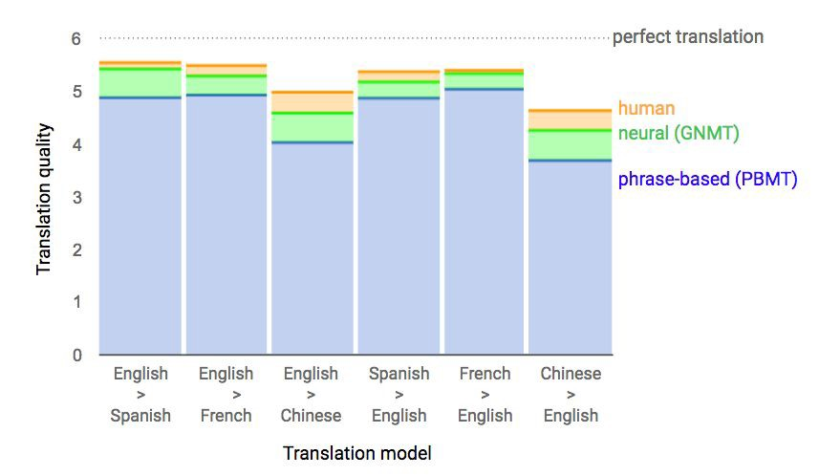
Relative Error Reduction

Slide 26
Recent Advances of NMT

Slide 27
This does not scale!
TRAINING TRAINING TIME DATA
MODELS
2-3
weeks per model
100M+
per model
~103²

Slide 28
Multilingual Model
Model several language pairs in single model
surprisingly this worked!
Prepend source with additional token to indicate target language
Translate to Spanish:
<2es> How are you </s> -> Cómo estás </s>
Translate to English:
<2en> Como estás </s> -> How are you </s>
No other changes to model architecture!

Slide 29
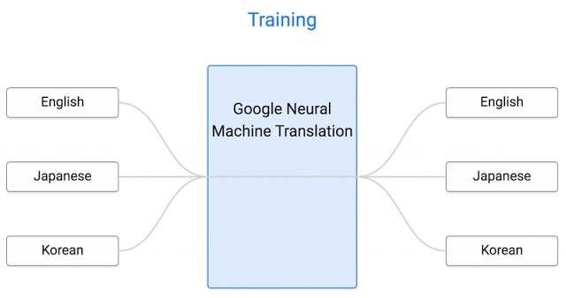
Multilingual Model
Zero-Shot Translation

Slide 30
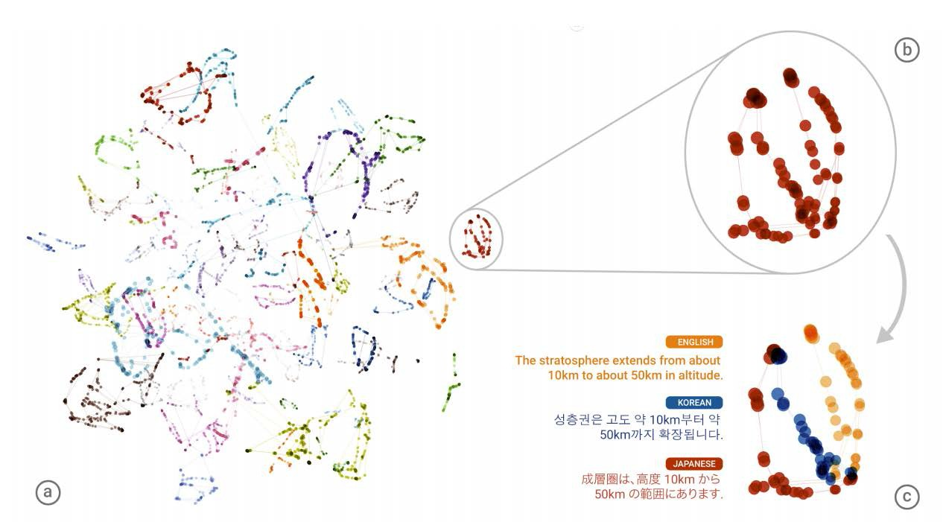
Visualization
A t-SNE projection of the embedding of 74 semantically identical sentences translated across all 6 possible directions

Slide 31
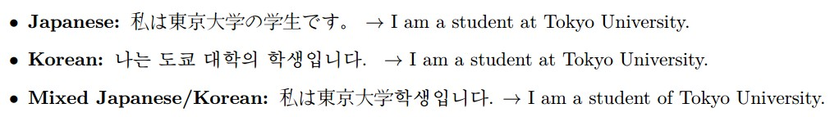
Source Language Code-Switching
Mixing Japanese and Korean in the source produces in many cases correct English translations

Slide 32
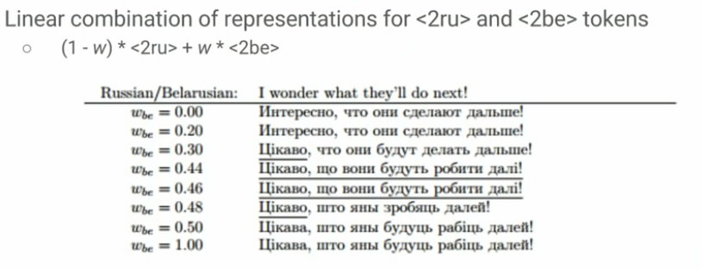
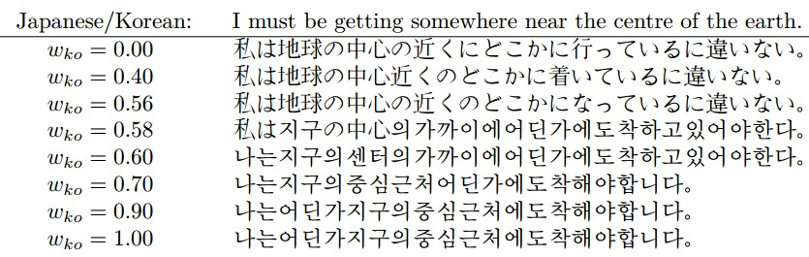
Weighted Target Language Selection
What happens when mixing target languages.

Slide 33
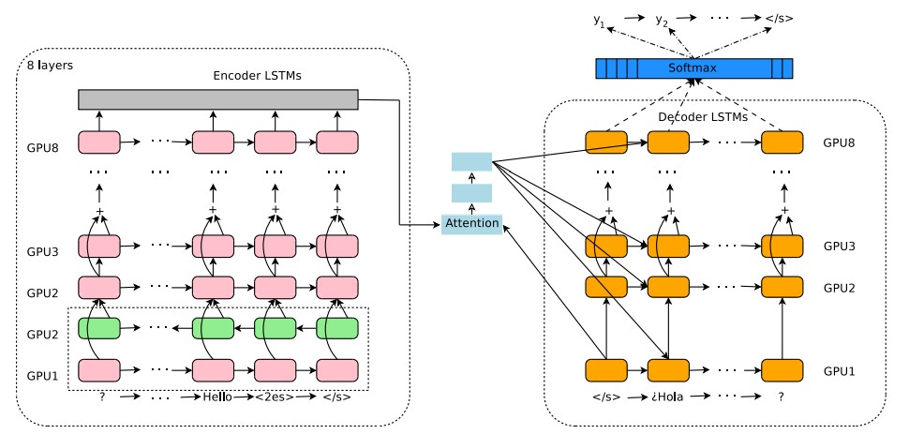
Big Picture

Slide 34
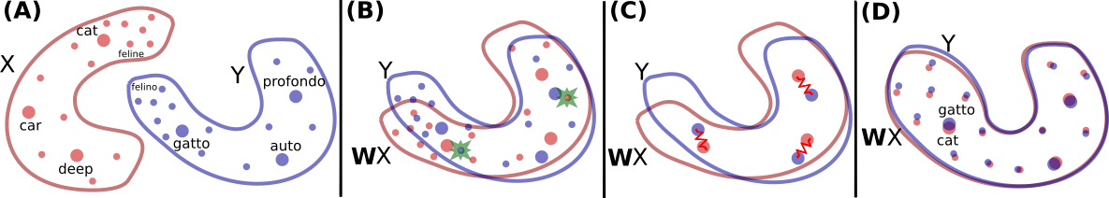
Unsupervised MT
A. Conneau*, G. Lample*, L. Denoyer, MA. Ranzato, H. Jégou, Word Translation Without Parallel Data

Slide 35
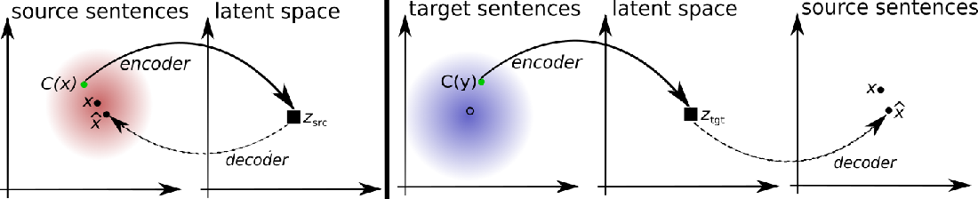
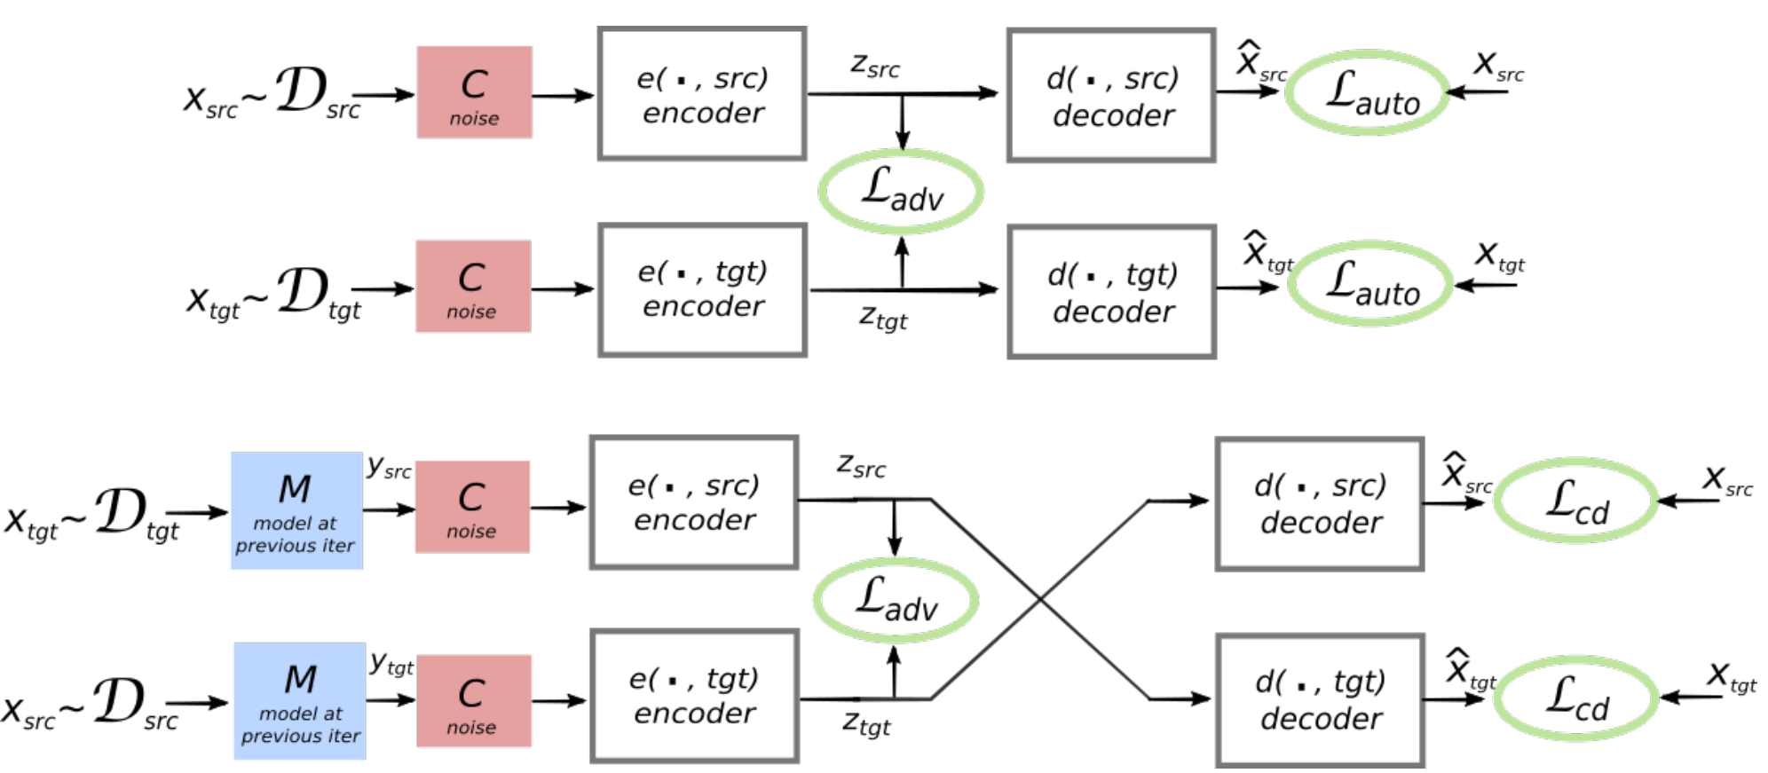
Unsupervised MT
G. Lample, L. Denoyer, MA. Ranzato Unsupervised Machine Translation With Monolingual Data Only

Slide 36
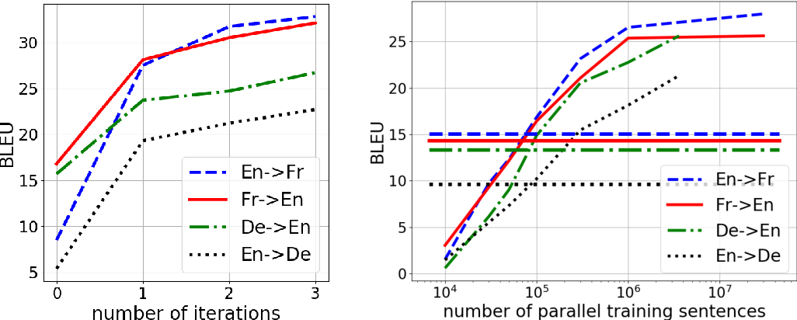
Unsupervised MT

Slide 37







Dual Learning
Primal Task 𝑓: 𝑥 → 𝑦
Agent
Agent
Unlabeled data 𝑥
Reconstructed data
𝑥′ = 𝑔(𝑦)
Feedback signals during the loop:
Predicted label
𝑦 = 𝑓(𝑥)
𝑅 (𝑥, 𝑓, 𝑔) = 𝑠 (𝑥, 𝑥′): reconstruction error.
𝐿(𝑦) and 𝐿(𝑥): Likelihoods.
Environment
Environment
Dual Task 𝑔: 𝑦 → 𝑥
Algorithms like policy gradient can be used to improve both primal and dual models according to feedback signals
MSRA NIPS 16

Slide 38
Dual Machine Translation as Example
En->Ch translation
Primal Task 𝑓: 𝑥 → 𝑦
Agent
Agent
English sentence 𝑥
New English sentence
𝑥′ = 𝑔(𝑦)
Feedback signals during the loop:
Chinese sentence
𝑦 = 𝑓(𝑥)
𝑅 (𝑥, 𝑓, 𝑔) = 𝑠 (𝑥, 𝑥′): BLEU of 𝑥′ given 𝑥 .
𝐿(𝑦) and 𝐿(𝑥): Language model of 𝑦 and 𝑥’.
Environment
Environment
Dual Task 𝑔: 𝑦 → 𝑥
Ch->En translation
MSRA NIPS 16

Slide 39




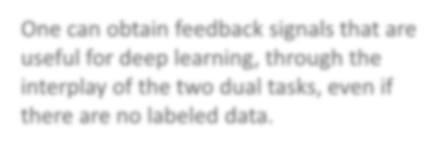
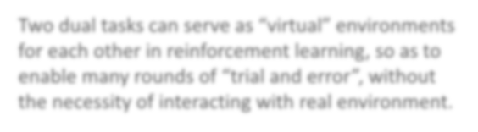
Dual AI tasks
Many real applications involve two dual AI tasks
Application | Primal task | Dual task
Machine translation | Translation from language A to B | Translation from language B to A
Speech processing | Speech recognition | Text to speech
Image understanding | Image captioning | Image generation
Conversation | Question answering | Question generation (e.g., Jeopardy!)
Search engine | Query-document matching | Query/keyword suggestion
One can obtain feedback signals that are useful for deep learning, through the interplay of the two dual tasks, even if there are no labeled data.
Two dual tasks can serve as “virtual” environments for each other in reinforcement learning, so as to enable many rounds of “trial and error”, without the necessity of interacting with real environment.

Slide 40




“Dual” Supervised Learning
max log 𝑃(𝑦|𝑥; 𝑓)
Primal Task 𝑓: 𝑥 → 𝑦
Agent
Agent
Labeled data 𝑥
Reconstructed data
𝑥′ = 𝑔(𝑦)
min |𝑃(𝑥) 𝑃 (𝑦|𝑥; 𝑓) − 𝑃(𝑦) 𝑃(𝑦|𝑥; 𝑔) |
Predicted label
𝑦 = 𝑓(𝑥)
Environment
Environment
Dual Task 𝑔: 𝑦 → 𝑥
max log 𝑃(𝑥|𝑦; 𝑔)
Feedback signals during the loop:
𝑅 (𝑥, 𝑓, 𝑔) = |𝑃(𝑥) 𝑃(𝑦|𝑥; 𝑓) − 𝑃(𝑦) 𝑃(𝑦|𝑥; 𝑔) |: the gap between
the joint probability 𝑃(𝑥, 𝑦) obtained in two directions

Slide 41
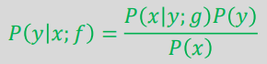


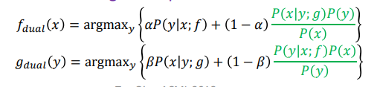
“Dual” Inference
Standard inference
Choose the 𝑦 that can maximize 𝑃(𝑦|𝑥; 𝑓)
Primal Task 𝑓: 𝑥 → 𝑦
Agent
Agent
Test data 𝑥
Reconstructed data
𝑥′ = 𝑔(𝑦)
Predicted label
𝑦 = 𝑓(𝑥)
Environment
Environment
Dual Task 𝑔: 𝑦 → 𝑥
Dual inference: leverage both the primal model and the dual model for testing

Slide 42
Dual Learning Papers
Yiren Wang, Yingce Xia, Tianyu He, Fei Tian, Tao Qin, ChengXiang Zhai, Tie-Yan Liu, Multi-Agent Dual Learning, ICLR 2019.
Yingce Xia, Xu Tan, Fei Tian, Tao Qin, Nenghai Yu, and Tie-Yan Liu, Model-Level Dual Learning, ICML 2018.
Hany Hassan, Anthony Aue, Chang Chen, Vishal Chowdhary, Jonathan Clark, Christian Federmann, Xuedong Huang, Marcin Junczys-Dowmunt, William Lewis, Mu Li, Shujie Liu, Tie-Yan Liu, Renqian Luo, Arul Menezes, Tao Qin, Frank Seide, Xu Tan, Fei Tian, Lijun Wu, Shuangzhi Wu, Yingce Xia, Dongdong Zhang, Zhirui Zhang, Ming Zhou, Achieving Human Parity on Automatic Chinese to English News Translation, arXiv 2018.
Jianxin Lin, Yingce Xia, Tao Qin, Zhibo Chen, and Tie-Yan Liu, Conditional Image-to-Image Translation, CVPR 2018.
Yijun Wang, Yingce Xia, Li Zhao, Jiang Bian, Tao Qin, Guiquan Liu, and Tie-Yan Liu, Dual Transfer Learning for Neural Machine Translation with Marginal Distribution Regularization, AAAI 2018.
Duyu Tang, Nan Duan, Tao Qin, Zhao Yan, and Ming Zhou, Question Answering and Question Generation as Dual Tasks, arXiv 2017.
Yingce Xia, Tao Qin, Wei Chen, Jiang Bian, Nenghai Yu and Tie-Yan Liu, Dual Supervised Learning, ICML 2017.
Yingce Xia, Jiang Bian, Tao Qin, Tie-Yan Liu, Dual Inference for Machine Learning, IJCAI 2017.
Di He, Yingce Xia, Tao Qin, Liwei Wang, Nenghai Yu, Tie-Yan Liu, and Wei-Ying Ma, Dual Learning for Machine Translation, NIPS 2016.

Slide 43
Neural Machine Translation, Tomorrow
Dynamic, heterogeneous background knowledge
NMT uses knowledge specific to a task
Information retrieval + machine translation
Use cases
Learning
Query
Neural Network
Neural Network
Access
Access

Slide 44
Any Questions?

